Slide 1
ROBOTIC Fundamentals (UFMF4X-15-M)
Homogenous Transformation
Notes:
https://www.youtube.com/watch?v=h11ljFJeaLo

Slide 2

Previously on
DOFs, Mobility, serial/parallel manipulators
Types of joints, Kinematic chains
Workspace, examples of serial manipulators
Refreshment of maths representation of matrices
Refreshment of your MATLAB skills
Questions?
Blackboard

Slide 3
Today’s Lecture
Frames for Forward Kinematics
Rotation & Translation of Frames
Homogenous transformation Matrix

Slide 4
reference frames and Forward Kinematics

Slide 5
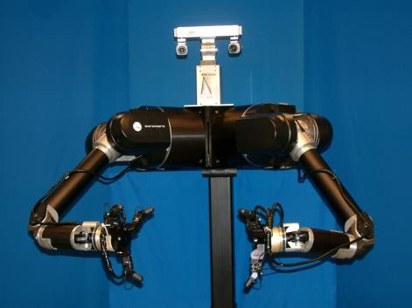
Forward Kinematics
Where is the end effector w.r.t. the “base” frame?

Slide 6
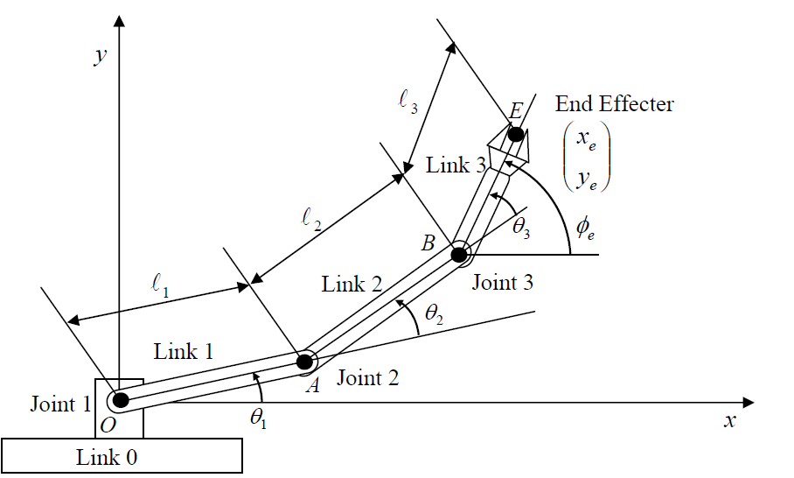


Planar RRR – Forward kinematics via Trigonometry
End effector

Slide 7
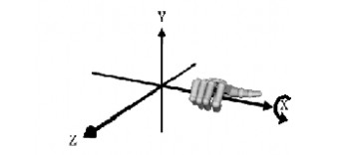
Vectors
Components of the vector are distances along x, y and z axis
Convention: right hand frames

Slide 8
Coordinate Frames
z
y
Right-handed
Co-ordinate frame
Camera Frame
x
x
Tool Frame
x
Link Frame
Goal Frame
x
x
Base
Frame
x

Slide 9
Example – Planar RRR
x
y
End effector
z
y
x
y
y
x
z
x
z
z

Slide 10
Moving between frames

Slide 11
Representing Displacement: Translation Vector
The reference frame of the hand {H} and the object {O} are spatially displaced.
We want to represent this difference in a consistent way.
{O}
{H}

Slide 12
Mapping: from frame to frame
Z_{B}
^{A}P
Z_{A}
^{B}P
{B}
Y_{B}
{A}
^{A}P_{BORG}
X_{B}
Y_{A}
X_{A}
If {A} has same orientation as {B}, then {B} differs from {A} in a translation: ^{A}P_{BORG}
^{A}P = ^{B}P + ^{A}P_{BORG}
Mapping: change of description from one frame to another. The vector ^{A}P_{BORG} defines the mapping.
Notes:
In this slide, assume that vector ^{B}P (expressed in frame {B}) is known and that we want to express it in frame {A} (^{A}P). By knowing the translation vector between the frames (their origins), ^{A}P_{BORG}, we can find ^{A}P.

Slide 13
Representing Orientation: Rotation Matrices
{H}
The reference frame of the hand {H} and the object {O} have different orientations
We want to represent different orientations in a consistent way, just like we did for positions…
{O}

Slide 14
Description of an Orientation
z_{A}
y_{A}
y_{B}
{A}
θ
{B}
x_{B}
x_{A}
z_{B}
We need a description of the angles to move from axes in {A} to axes in {B}
Or in other words: a description of {B} with respect to {A}

Slide 15
Rotation between two frames

Slide 16
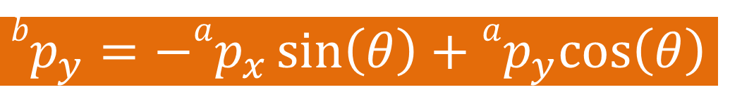


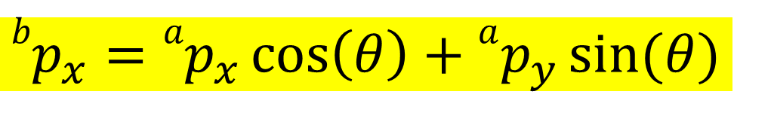
Rotation between two frames
$${ap}_{y}$$
θ
θ
$${ap}_{x}$$
$${bp}_{y}=−ap_{x}\sin\left(θ\right)+ap_{y}cos\left(θ\right)$$
$${bp}_{x}={ap}_{x}\cos\left(θ\right)+ap_{y}\sin{(θ)}$$
Notes:
The rotation is 23 degrees.
https://www.youtube.com/watch?v=h11ljFJeaLo

Slide 17

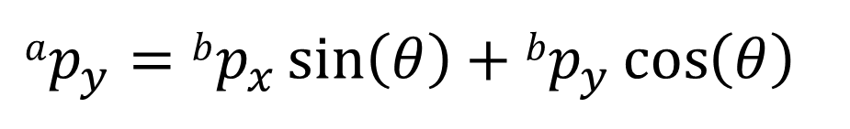
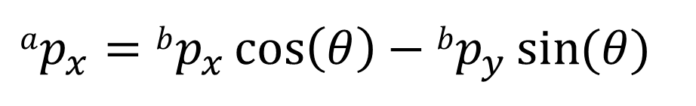
Rotation Matrix
$$bp_{x}=ap_{x}\cos\left(θ\right)+ap_{y}\sin{(θ)}$$
$$bp_{y}=−ap_{x}\sin\left(θ\right)+ap_{y}\cos\left(θ\right)$$
This way, we had a point (or vector) which was in frame {A} and we have expressed it in {B}
To express a point (or vector) from {B} to {A}, the equations are:
$$ap_{x}=bp_{x}\cos\left(θ\right)−bp_{y}\sin{(θ)}$$
$$ap_{y}=bp_{x}\sin\left(θ\right)+bp_{y}\cos\left(θ\right)$$

Slide 18
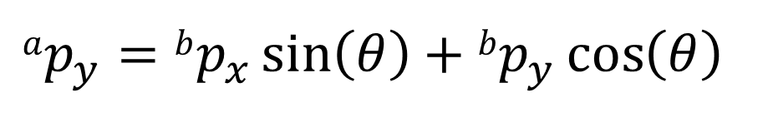
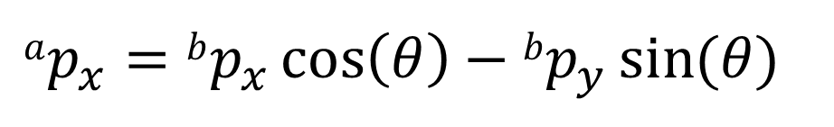
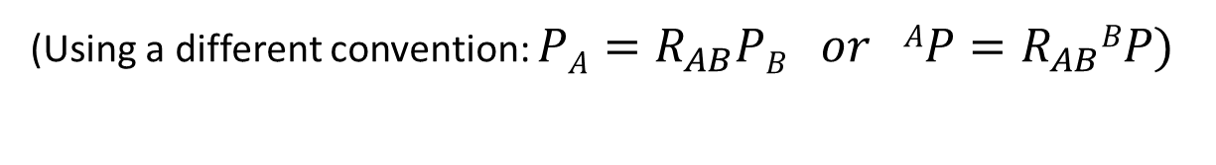
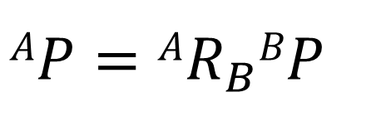
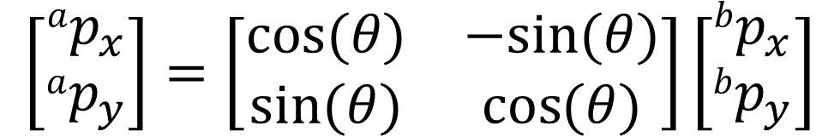
Rotation Matrix
To express a point (or vector) from {B} to {A}, the equations are:
$$ap_{x}=bp_{x}\cos\left(θ\right)−bp_{y}\sin{(θ)}$$
$$ap_{y}=bp_{x}\sin\left(θ\right)+bp_{y}\cos\left(θ\right)$$
$$\left[\begin{matrix}ap_{x} \\ ap_{y}\end{matrix}\right]=\left[\begin{matrix}cos⁡(θ) & −sin⁡(θ) \\ sin⁡(θ) & \cos{(θ)}\end{matrix}\right]\left[\begin{matrix}bp_{x} \\ bp_{y}\end{matrix}\right]$$
$$AP=AR_{B}BP$$
(Using a different convention: $PA=R_{AB}PB or AP=R_{AB}BP)$

Slide 19
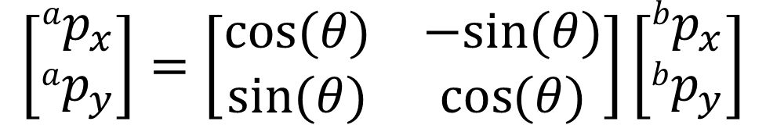

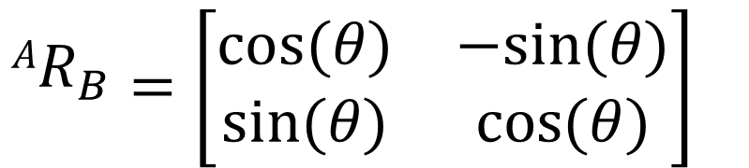
Rotation Matrix
$$\left[\begin{matrix}ap_{x} \\ ap_{y}\end{matrix}\right]=\left[\begin{matrix}cos⁡(θ) & −sin⁡(θ) \\ sin⁡(θ) & \cos{(θ)}\end{matrix}\right]\left[\begin{matrix}bp_{x} \\ bp_{y}\end{matrix}\right]$$
$${AR}_{B}=\left[\begin{matrix}cos⁡(θ) & −sin⁡(θ) \\ sin⁡(θ) & \cos{(θ)}\end{matrix}\right]$$
The rotation matrix ${AR}_{B}$ is described as the rotation matrix for transforming from the frame {B} to the frame {A}.

Slide 20

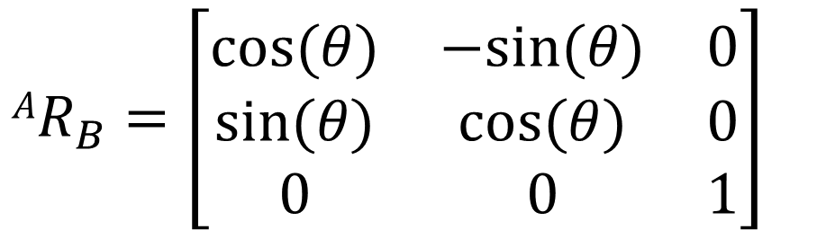

Rotation Matrix: from 2D to 3D
$$ap_{x}=bp_{x}\cos\left(θ\right)−bp_{y}\sin{(θ)}$$
$$ap_{y}=bp_{x}\sin\left(θ\right)+bp_{y}\cos\left(θ\right)$$
$$ap_{z}=bp_{z}$$
The 3D rotation matrix ${AR}_{B}$ is given as:
$${AR}_{B}=\left[\begin{matrix}cos⁡(θ) & −sin⁡(θ) & 0 \\ sin⁡(θ) & cos⁡(θ) & 0 \\ 0 & 0 & 1\end{matrix}\right]$$
or $R_{AB}$ or ${}_{B}^{A}R$

Slide 21
Rotation matrices (rotation around x/y/z)
where:

Slide 22
Example with Rotation Matrices
Y_{B}
Y_{W}
X_{W}
30º
X_{B}

Slide 23
Properties of Rotation Matrices to keep in mind

Slide 24
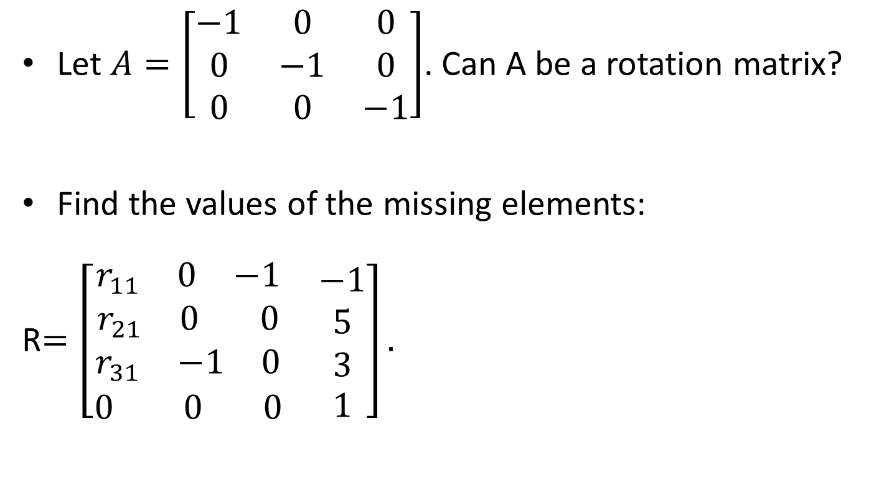
Homework
Let $A=\left[\begin{matrix}−1 & 0 & 0 \\ 0 & −1 & 0 \\ 0 & 0 & −1\end{matrix}\right]$. Can A be a rotation matrix?
Find the values of the missing elements:
R$=\left[\begin{matrix}\begin{matrix}\begin{matrix}r_{11} & 0 & −1\end{matrix} \\ \begin{matrix}r_{21} & 0 & 0\end{matrix} \\ \begin{matrix}r_{31} & −1 & 0\end{matrix}\end{matrix} & \begin{matrix}−1 \\ 5 \\ 3\end{matrix} \\ \begin{matrix}0 & 0 & 0\end{matrix} & 1\end{matrix}\right].$

Slide 25
Homogeneous Transformations
Putting it all together

Slide 26
In summary
Position of a point is represented by a vector
Orientation of a body is represented by a matrix

Slide 27
Kinematic Relationship
Between two frames we have a kinematic relationship - translation and rotation.
This relationship is mathematically represented by a 4 × 4 Homogeneous Transformation Matrix.
z
x
y
y
z
x

Slide 28
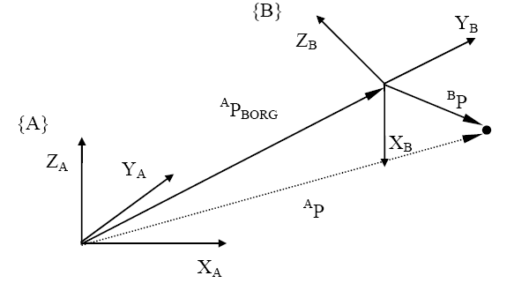
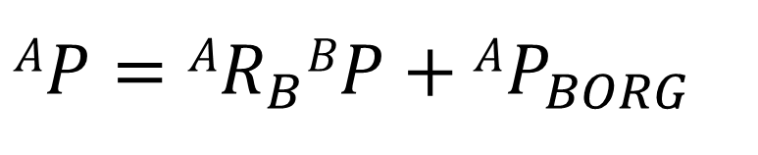
Mapping of the frames (Translation + Rotation)
P
$$AP=AR_{B}BP+AP_{BORG}$$

Slide 29
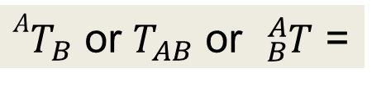
Homogenous transformation matrix
${AT}_{B}$ or $T_{AB}$ or ${}_{B}^{A}T$ =

Slide 30
Homogeneous Coordinates
Homogeneous coordinates: embed 3D vectors into 4D by adding a “1”
More generally, the transformation matrix T has the form:
a₁₁ a₁₂ a₁₃ b₁
a₂₁ a₂₂ a₂₃ b₂
a₃₁ a₃₂ a₃₃ b₃
c₁ c₂ c₃ sf
Notes:
The row vector [c₁ c₂ c₃] is useful in specifying perspective transformations by modifying the homogenous coordinate component to be a function of the other 3 coordinates. For example, this is used in computer graphics.
The scalar sf represents an overall scale factor in the transformation. Always 1 in robot kinematics.

Slide 31
Compound transformations
Getting many of them together

Slide 32
Compound Transformations

Slide 33
Compound Transformations
The vector ^{W}C may be known, but ^{E}C needs to be calculated. If the transformations representing the position and orientation of {W} w.r.t. {B} and {B} w.r.t. to {E} are known, the following calculations can be performed:
^{B}C = ^{B}T_{W} ^{W}C
^{E}C = ^{E}T_{B} ^{B}C
or these equations can be combined to give:
^{E}C = ^{E}T_{B} ^{B}T_{W} ^{W}C
Combining the transformations we can define:
^{E}T_{W} = ^{E}T_{B} ^{B}T_{W}
{E}
^{E}C
^{W}C
{W}
C
{B}

Slide 34
Inverse transformations
In the previous slide we may know ^{B}T_{E} (description of the frame E relative to frame B) rather than ^{E}T_{B}. Or it may be necessary to calculate the position of an object relative to the hand of a robot from its position in relation to the world co-ordinate system.
To do this we find an inverse transformation. In general:

Slide 35
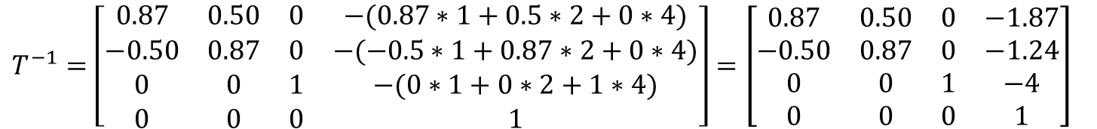
Example: Inverting a Transformation matrix
If the transformation matrix T is given by
$$T^{−1}=\left[\begin{matrix}0.87 & 0.50 & 0 & −(0.87∗1+0.5∗2+0∗4) \\ −0.50 & 0.87 & 0 & −(−0.5∗1+0.87∗2+0∗4) \\ 0 & 0 & 1 & −(0∗1+0∗2+1∗4) \\ 0 & 0 & 0 & 1\end{matrix}\right]=\left[\begin{matrix}0.87 & 0.50 & 0 & −1.87 \\ −0.50 & 0.87 & 0 & −1.24 \\ 0 & 0 & 1 & −4 \\ 0 & 0 & 0 & 1\end{matrix}\right]$$
Prove:
where I is the identity matrix

Slide 36
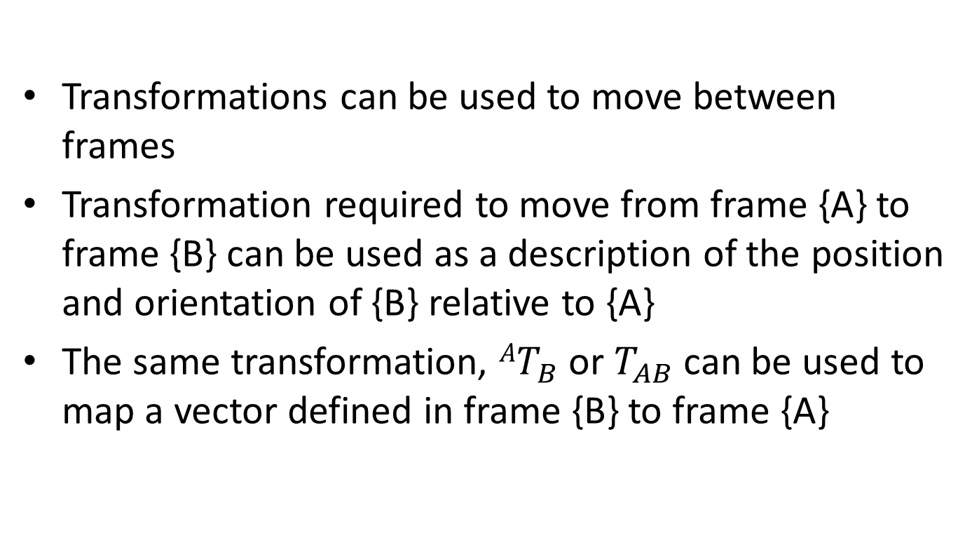
Using transformations to describe frames
Transformations can be used to move between frames
Transformation required to move from frame {A} to frame {B} can be used as a description of the position and orientation of {B} relative to {A}
The same transformation, ${AT}_{B}$ or $T_{AB}$ can be used to map a vector defined in frame {B} to frame {A}

Slide 37
Example
Figure 1 shows the positions and orientations of Frames A and B. Determine
z_{A}
5
y_{B}
y_{A}
x_{B}
z_{B}
3
x_{A}
2

Slide 38
Example
Figure 1 shows the positions and orientations of Frames A and B. Determine
z_{A}
5
y_{A}
x_{A}
3
2

Slide 39
Example
Figure 1 shows the positions and orientations of Frames A and B. Determine
z_{A}
y_{B}
y_{A}
x_{B}
z_{B}
x_{A}

Slide 40
Example
Figure 1 shows the positions and orientations of Frames A and B. Determine
z_{A}
y_{B}
y_{A}
x_{B}
z_{B}
x_{A}

Slide 41
Example
Figure 1 shows the positions and orientations of Frames A and B. Determine
y_{A}
z_{A}
y_{B}
x_{A}
x_{B}
z_{B}

Slide 42
Example
Figure 1 shows the positions and orientations of Frames A and B. Determine
z_{A}
5
y_{B}
y_{A}
x_{B}
z_{B}
3
x_{A}
2

Slide 43
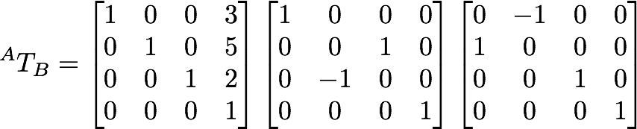
Example
Figure 1 shows the positions and orientations of Frames A and B. Determine
z_{A}
5
y_{B}
y_{A}
x_{B}
z_{B}
3
x_{A}
2

Slide 44
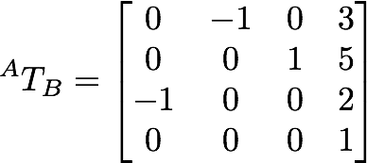
Example
Figure 1 shows the positions and orientations of Frames A and B. Determine
z_{A}
5
y_{B}
y_{A}
x_{B}
z_{B}
3
x_{A}
2

Slide 45
Alternative Rotation Representation
Unit Vectors
Euler Angles
Quaternions
SVD (not going to see this)
Notes:
SVD: singular value decomposition

Slide 46
Rotation Matrices using Unit Vectors
Dot product!
Especially for when we only have rotations of 90 degrees around axes!
Let v={x_{a},y_{a},z_{a}} and w={x_{b},y_{b},z_{b}}:
If v||w →v∙w=1 if vꞱw→ v∙w=0 if v||-w→ v∙w=-1
Notes:
Dot product of two unit vectors yields the cosine between them.
In the rotation matrix above, six independent equations can be defined with 9 unknowns.

Slide 47
In the previous example…
z_{A}
5
y_{B}
y_{A}
x_{B}
z_{B}
3
x_{A}
2

Slide 48
Euler Angles
Orientation represented as a vector of 3 angles
Orientation frequently specified by a sequence of rotations about the X, Y, and Z axes.
A sequence of rotations around principle axes is called an Euler Angle Sequence
Minimal representation of orientation

Slide 49
Euler Angles
This gives us 12 redundant ways to store an orientation using Euler angles
Different industries use different conventions for handling Euler angles (or no conventions)
XYZ | XZY | XYX | XZX
YXZ | YZX | YXY | YZY
ZXY | ZYX | ZXZ | ZYZ

Slide 50
Euler Angles ZXZ, Animated
w'=
z
w'"=
w"
α
v'"
v "
γ
v'
y
u'"
β
u'
=u"
x

Slide 51
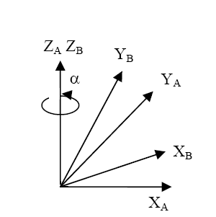
Euler Angles ZYZ – Rotation Matrix

Slide 52
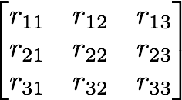
ZYZ from Homogenous matrix
Singularity for the last two angles
when β=0 or 180
Notes:
Where Atan2 computes tan⁻¹(y/x) but uses the signs of both x and y to determine the quadrant in which the resulting angle lies.

Slide 53
ZYX – Roll-Pitch-Yaw (RPY)
Z
Y
X

Slide 54
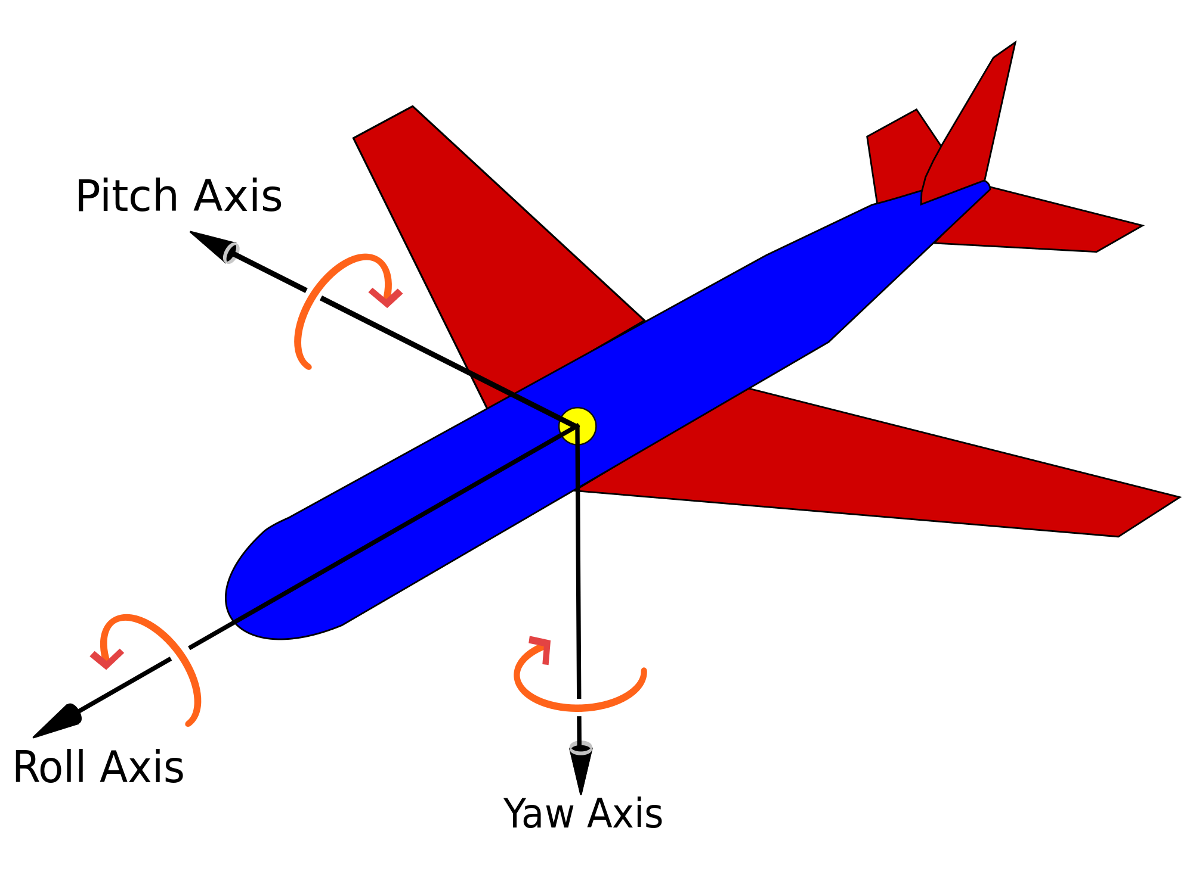
RPY – Vehicle Orientation
Notes:
Intuitive Representation

Slide 55
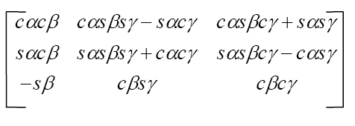
RPY – Rotation Matrix

Slide 56
RPY from Homogenous matrix
Singularity for the last two angles
when β=90º or 270º

Slide 57
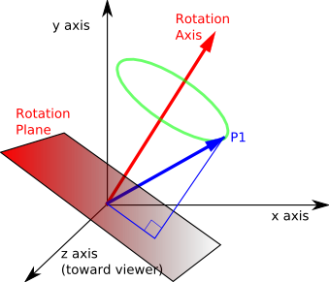
Quaternions – Basic Concept

Slide 58
Quaternions – Rotation as axis/angle
Any rotation is:
So it is safe to describe it as:
where x, y, z are coordinates of axis of rotation.
θ

Slide 59
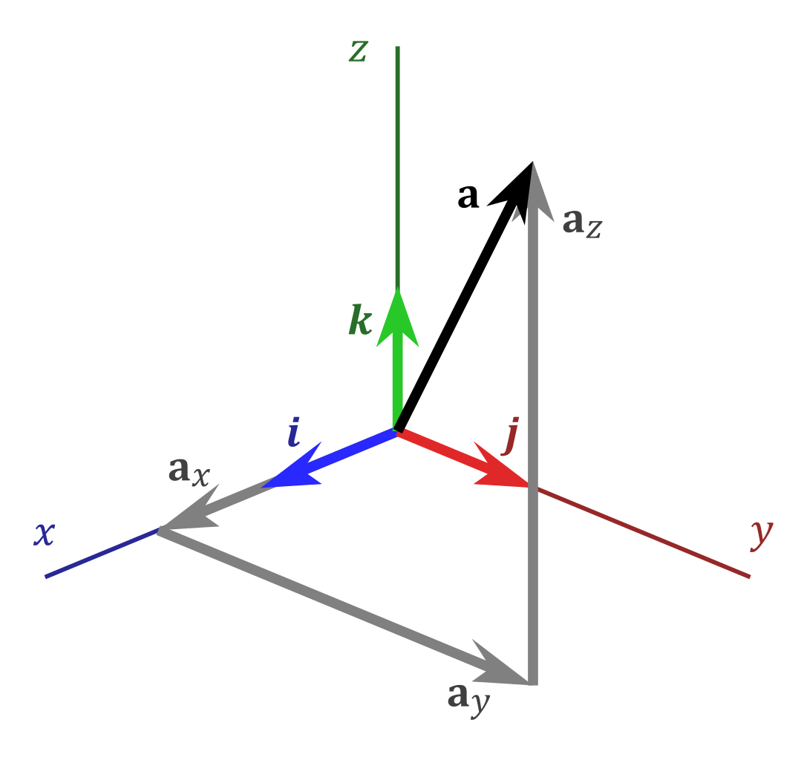
Quaternions – The Complex Number 3D space
Unit quaternions
(length = 1)

Slide 60
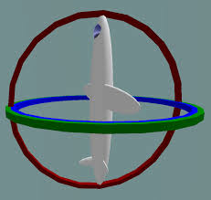
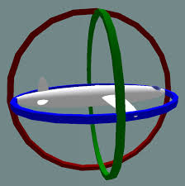
Quaternions – Advantages of Quaternions
Combination of Rotations (Simpler Computations)
Rounding error robustness
No Gimbal Lock Issue
Notes:
A Gimbal is a hardware implementation of Euler angles (used for mounting gyroscopes, expensive globes).
Gimbal lock is a basic problem with representing 3-D rotations using Euler angles.
https://www.youtube.com/watch?v=zc8b2Jo7mno

Slide 61
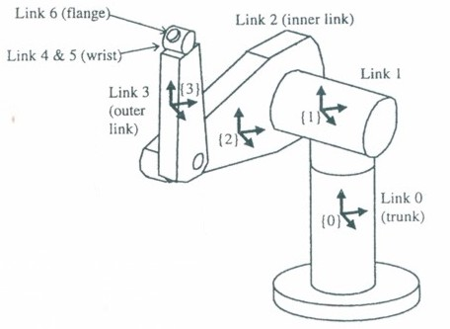
Forward kinematics – Composition of Homogeneous Transformations
For the Puma robot, the transformation ⁰T₆ is the solution to the forward kinematics problem:
⁰T₆ = ⁰T₁ ¹T₂ ²T₃ ³T₄ ⁴T₅ ⁵T₆

Slide 62
Composition of homogeneous transforms
Base to eff transform
Transform associated w/ link 3
Transform associated w/ link 2
Transform associated w/ link 1

Slide 63
Composition of homogeneous transforms

Slide 64
Composition of homogeneous transforms

Slide 65
Composition of homogeneous transforms
where:

Slide 66
…Remember those trigonometric identities…
…and some more commonly used formulas…
S
A
T
C
Notes:
Quadrants: 1st – all (sin, cos, tan) are positive
2nd – only sine is positive
3rd – only tangent is positive
4th – only cosine is positive

Slide 67
Summary
Kinematics and Reference frames – Basis of the Analysis
Connecting Frames – Translation Vectors and Rotation Matrices
Unified Representation – Homogeneous Transformations – Compound Transformations

Slide 68
Rotation Representation

